Slide 1
Black Box and White Box Testing

Slide 2
What is white box testing?
White box tests the functionality and inner workings of the code.
It is a testing used for developers rather than users
It is called White box or sometimes glass box as it refers to the code that the user doesn’t see (see through)
Tests the security, flow of input and output
Generally each line of code is tested atleast once during a white box test.
This is the first part to box testing.

Slide 3
What is white box testing used for?
Minimising security weaknesses to prevent hacking
Increasing efficiency and structure of the code
Checking what is done on the input for code.
The expected outputs based on inputs in the code (any differences is a bug)
Checking each function/statement is working as intended.

Slide 4
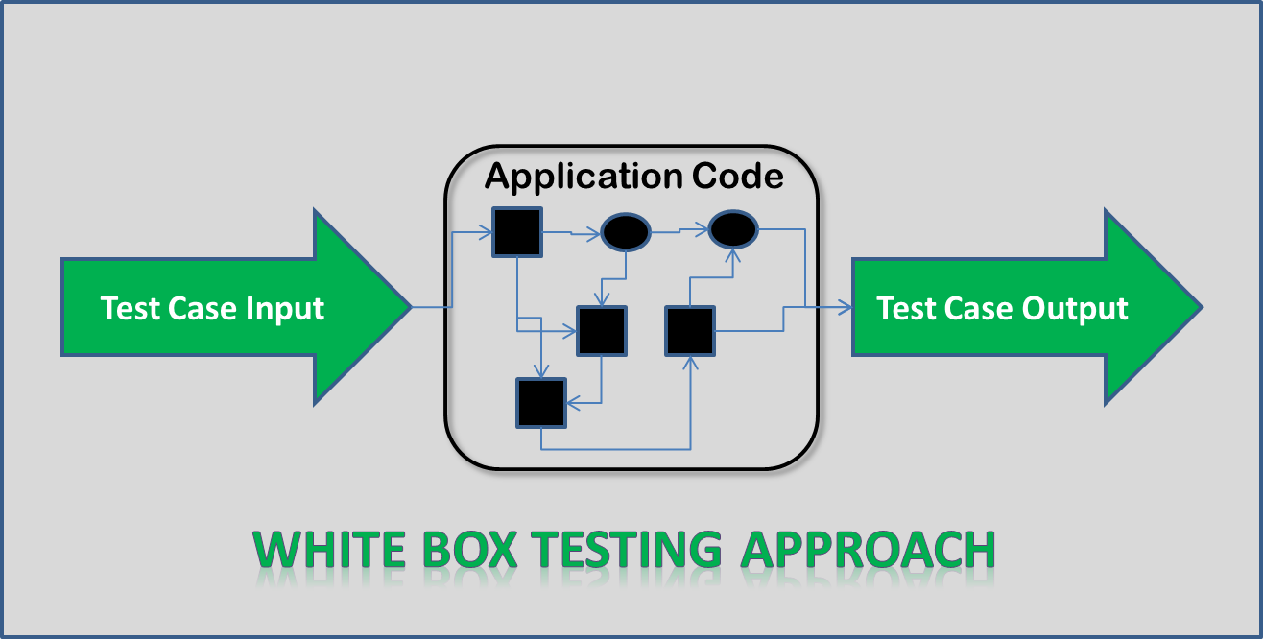
How is white box testing done?
Create a test case for each situation or possible input a user can enter
Make sure every single line of the code has been executed atleast once and shown desired output
If there is an if/else statement or any loop, make sure it goes through the conditions and check output.
For example assignment 1 the different error checks
Each different possibility was tested atleast once during the 80 different test cases
Every single line of code had been tested and returned a pass or fail based on your output vs expected output.

Slide 5
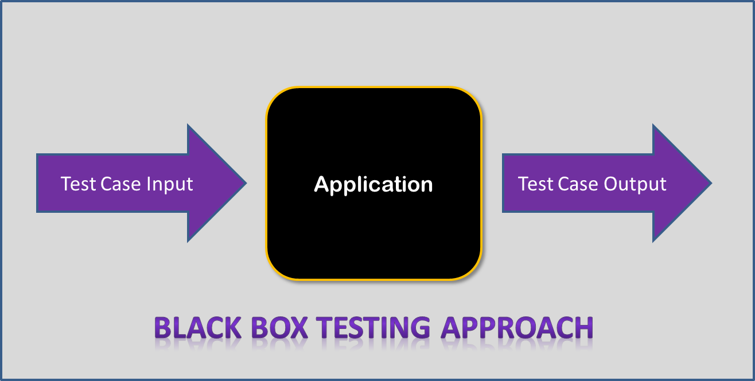
What is black box testing?
Black box testing is the counterpart to white box testing
Black box testing is testing from the user’s perspective
It is called Black box testing because the user cannot see the inner workings and only seeing the outputs of the code.
Checks functionality requirements, usability, performance.

Slide 6
What is black box testing used for?
Checking overall user experience
Checks to see if the code is working as intended without seeing the code
Checks the performance

Slide 7
How is black box testing done?
A software tester plays around with the code inputting any input both valid and invalid.
The software tester then writes down what his expected output is for every input.
A test case is written for each input and then run.
Then there is a comparison between output software tester wrote vs what is the output the program has.
Fix any differences and re-test till code works as intended.

Slide 8
Testing point.c with different test cases

